Slide 1
Secure Data Hiding In Images Using Steganography
Presented By: Omkar Surve
Student Name: Omkar Surve
College Name: Bunt Sanghas S.M. Shetty Colleg of Science, Commerce and Management Studies.
Department: B.Sc Data Science

Slide 2
OUTLINE
Problem Statement
Technology used
Wow factor
End users
Result
Conclusion
Git-hub Link

Slide 3
Problem Statement
With the rapid advancement of digital communication, ensuring data security and confidentiality has become a major concern.
Traditional encryption methods protect data from unauthorized access, but they can also attract attention by signaling the presence of hidden information.
Steganography, the practice of concealing data within multimedia files such as images, offers an alternative approach to secure communication by making the existence of hidden data imperceptible.
The primary objectives of this project are:
To implement a simple and efficient image steganography technique for hiding textual data.
To ensure that the visual quality of the image remains unchanged after embedding the data.
To provide a method for extracting the hidden information from the image.
To analyze the effectiveness and limitations of the chosen technique in terms of security and robustness.

Slide 4
Technology used
Programming Language: Python
Image Processing Library: OpenCV
Environment: PyCharm
Platform: Windows 11

Slide 5
Wow factors
Invisible Communication – The hidden data remains undetectable to the human eye, ensuring secret transmission without raising suspicion.
Data Integrity – The extracted data remains unchanged and intact, preserving its original meaning and accuracy.
Minimal Image Distortion – The embedded information does not significantly affect the visual quality of the image.
Dual-layer Security – Combining steganography with encryption enhances protection against cyber threats.
Cross-Platform Compatibility – The steganographic images can be shared across different devices without data loss.

Slide 6
END Users
Cybersecurity Enthusiasts – Exploring secure communication techniques.
Government & Defense – Secure message transmission without raising suspicion.
Journalists & Activists – Concealing sensitive information in images to avoid surveillance.
Software Developers – Learning steganography concepts and their applications.

Slide 7
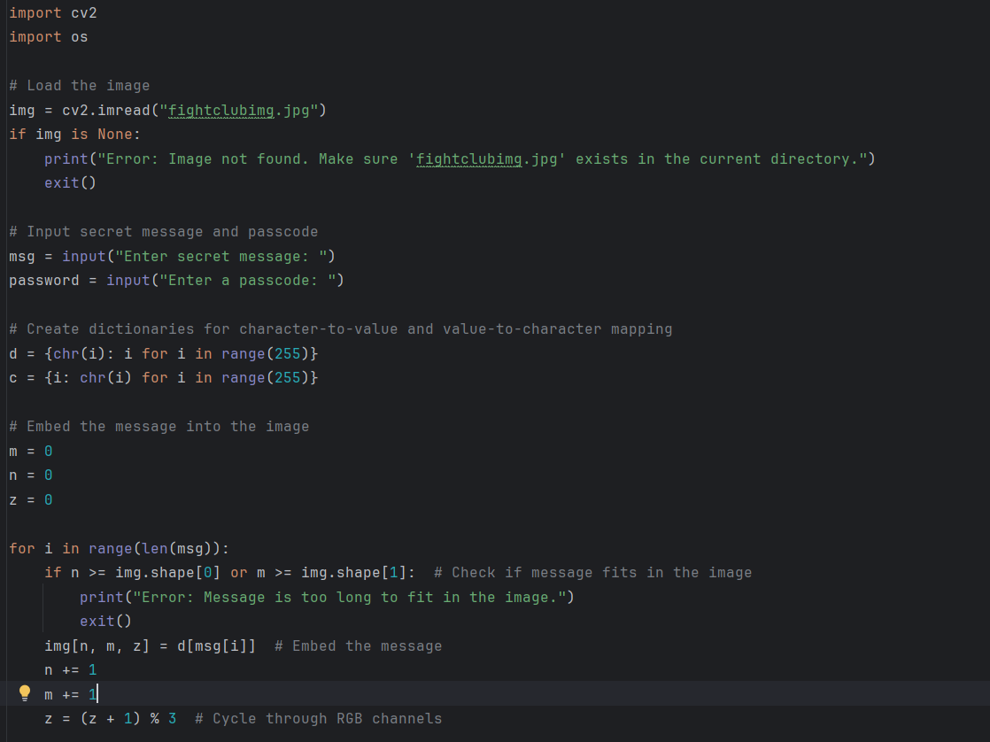
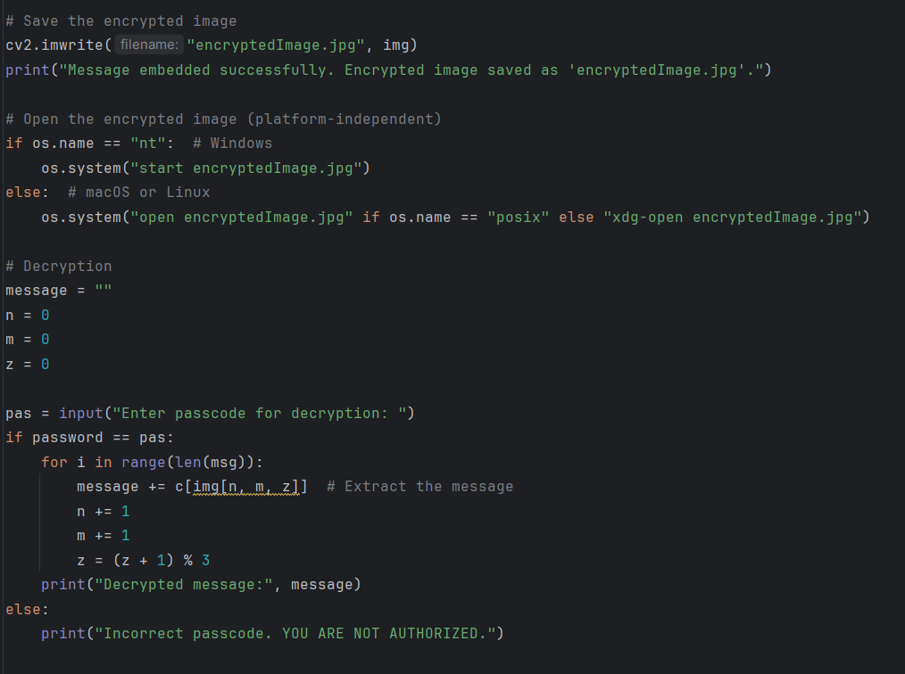
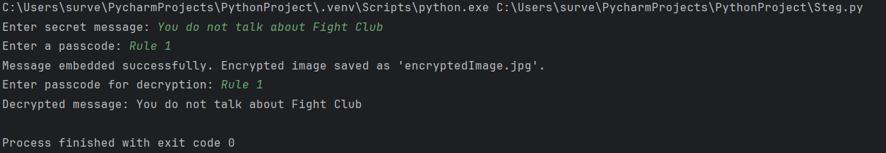
Results
Code:
Output :

Slide 8

Input Image
Output Image

Slide 9
Conclusion
Steganography provides a covert way of communicating sensitive information.
This project showcases a simple yet effective implementation of message hiding in images.
The GUI makes encryption and decryption accessible even to non-technical users.
Future improvements can make it more robust, secure, and scalable.

Slide 10
GitHub Link
https://github.com/OmkarrSurve/Steganography

Slide 11
THANK YOU

